Slide 1
20m Resisted Sprint Time Analysis in Elite Male Non-Professional Basketball Athletes
By: Angeleau Scott, MS, CSCS, CPSS, CES, USAW-2
DATA 824
07/17/25

Slide 2
Background
Basketball is a mixed energy-system sport requiring performance characteristics such as, fast force production in multiple directional planes, agility, and sprint performance, and jumping capabilities(Klinzing, 1991; Latin et al., 1994)
Basketball players must be able to jump for shooting, blocking, and rebounding, sprint, walk, jog, accelerate, decelerate, cut, when required in practice and competition_{(Drinkwater et al., 2008)}
Significant correlations have been found between jumping ability, agility performance, and sprint time in elite youth basketball players_{(Asadi, 2016)}

Slide 3
Question, Methodology, and visualization
Question:
- What players in a group of elite young adult male basketball players have the top speeds, in mph?
Methods:
15-male non-professional basketball players performed one 20-meter sprint while wearing a 1kg weighted vest, one after the next.
Visualization:
How can we see who had the top speed and what can we take away?

Slide 4
Shiny App
Goals of Shiny App:
Allow user to select a file type, in this case “Twenty_Meter_Sprint_Times_Descending_Order.xlsx”. The user can then view the entire dataset (all rows and columns)
View simple descriptives (mean, median, standard deviation, etc.)
Allow the user to view scatterplots, 2D Bin graphs, Histograms, Bar Charts, and view PCA related graphs based on the x and y axis they choose to view; along with coloring or grouping by whatever variable they would like (often times the “Client” variable).
In our case, viewing across time, which athlete had the top speed.
In the following graphs, client, subject, or S#, refers to an individual subject.

Slide 5
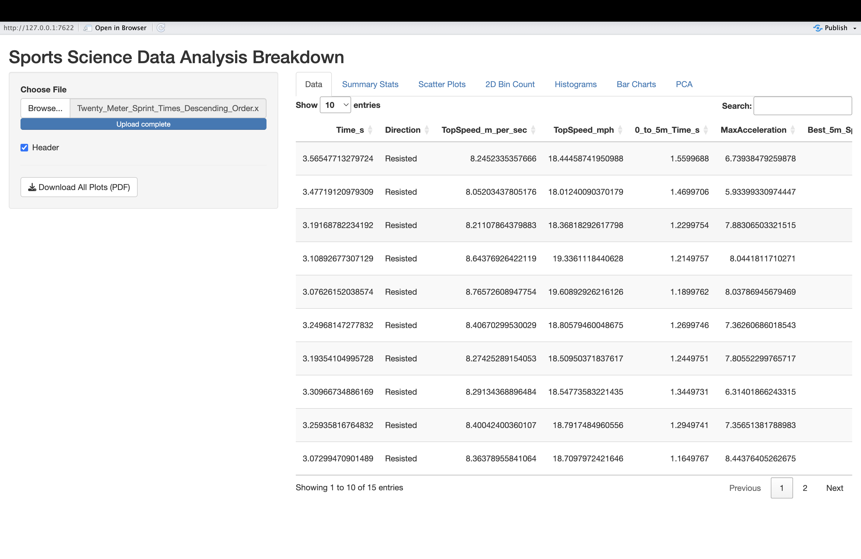
Data
On the sidebar panel, a user can select any type of file to load into the app (.doc, .txt, .csv, or .xlsx).
After loading in the excel file called “Twenty_Meter_Sprint_Times_Descending_Order.xlsx”, we can see the column “TopSpeed_mph”

Slide 6
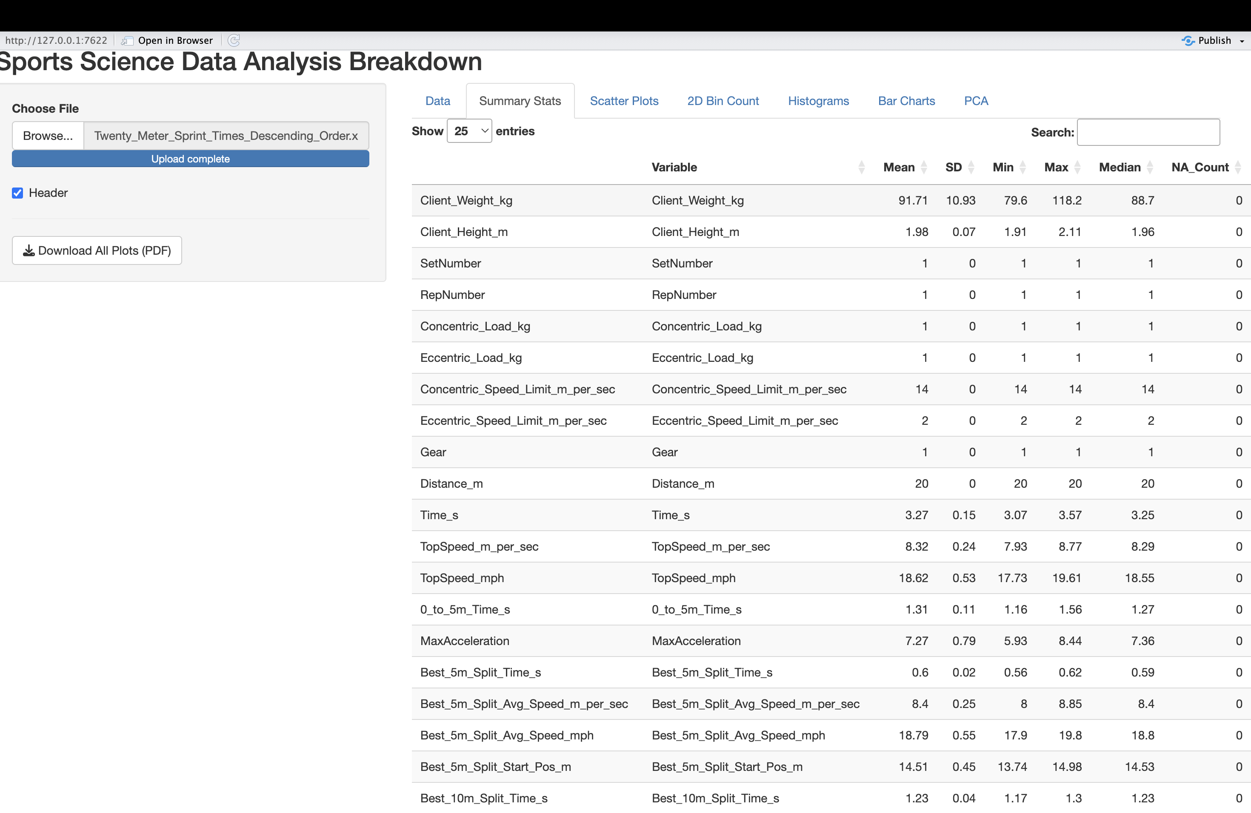
Summary Stats
The Summary Stats tab allows the user to view descriptive statistics of each of the columns in the Data sheet they imported in the Sidebar Panel of the shiny app.
This spovides the various column headings explaining the variable name, followed by the mean, SD, Min, Max, Median and NA count (how many missing values) for each variable

Slide 7
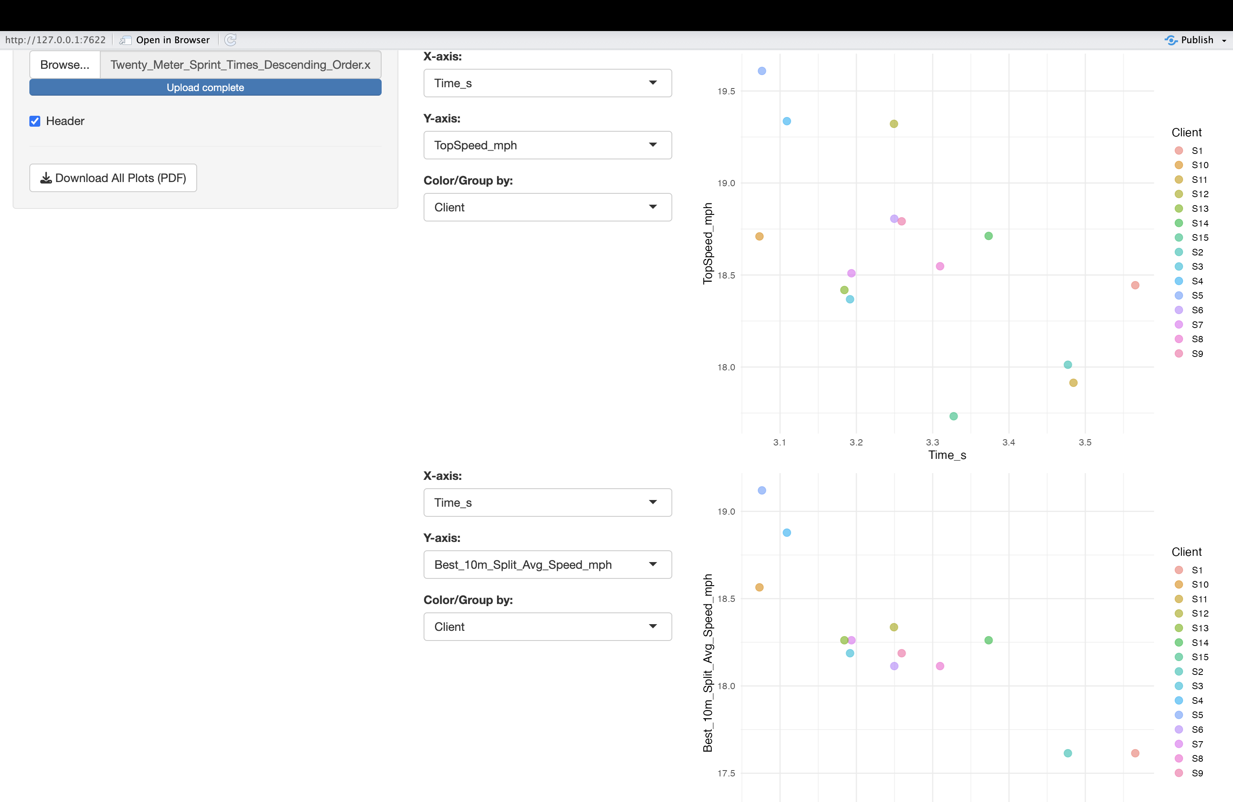
Scatter plots
Scatter plots are used to graphically portray the relationship between two continuous numerical variables while also identifying potential correlations or patterns.
This color-coded scatter plot shows that the red circled dot, Subject 5, S5, had the top speed.

Slide 8
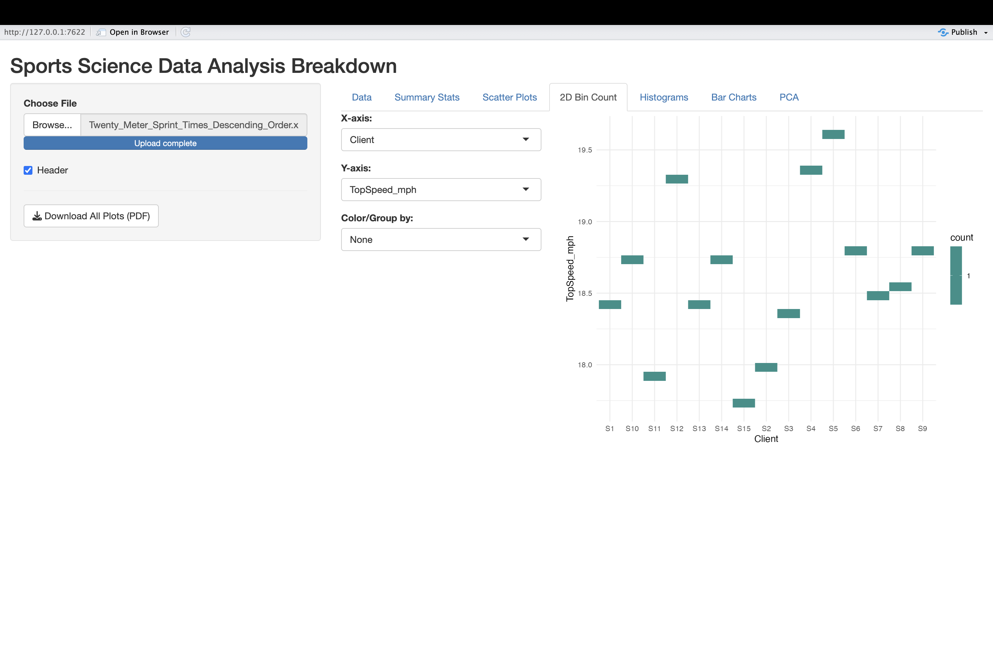
2D Bin Count
2D Bin counts are used to visualize the density of data points of two-variables
Here is another way to see that S5 had the top speed.

Slide 9
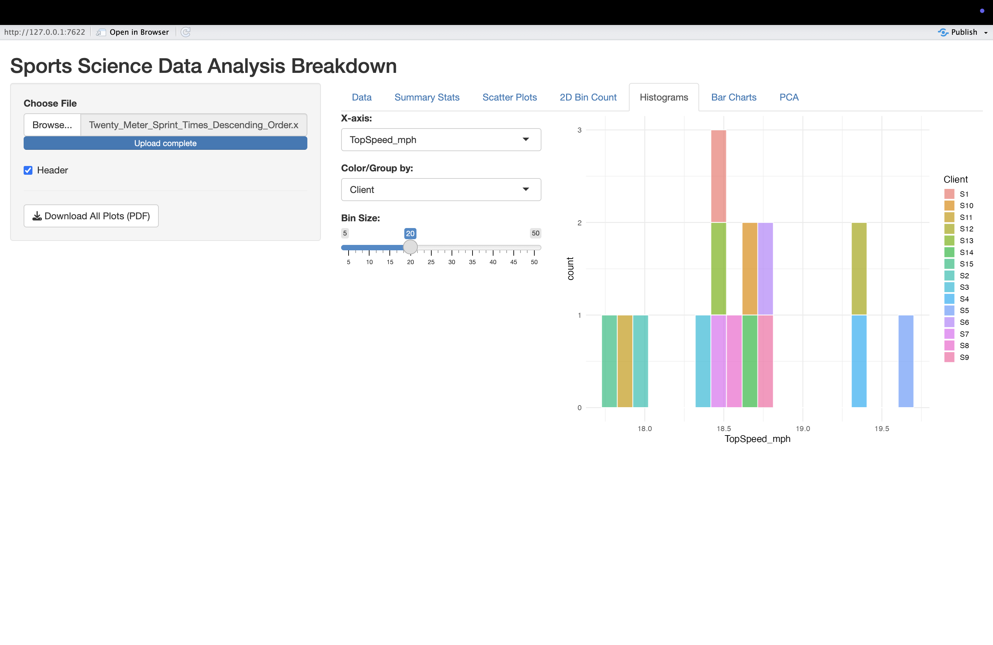
Histogram
Histograms are used to visually summarize the distribution of a single continuous variable by showing how often data falls into different ranges (or bins).
This color-coded histogram shows, based upon top speed on the x-axis, what top speed each client had.

Slide 10
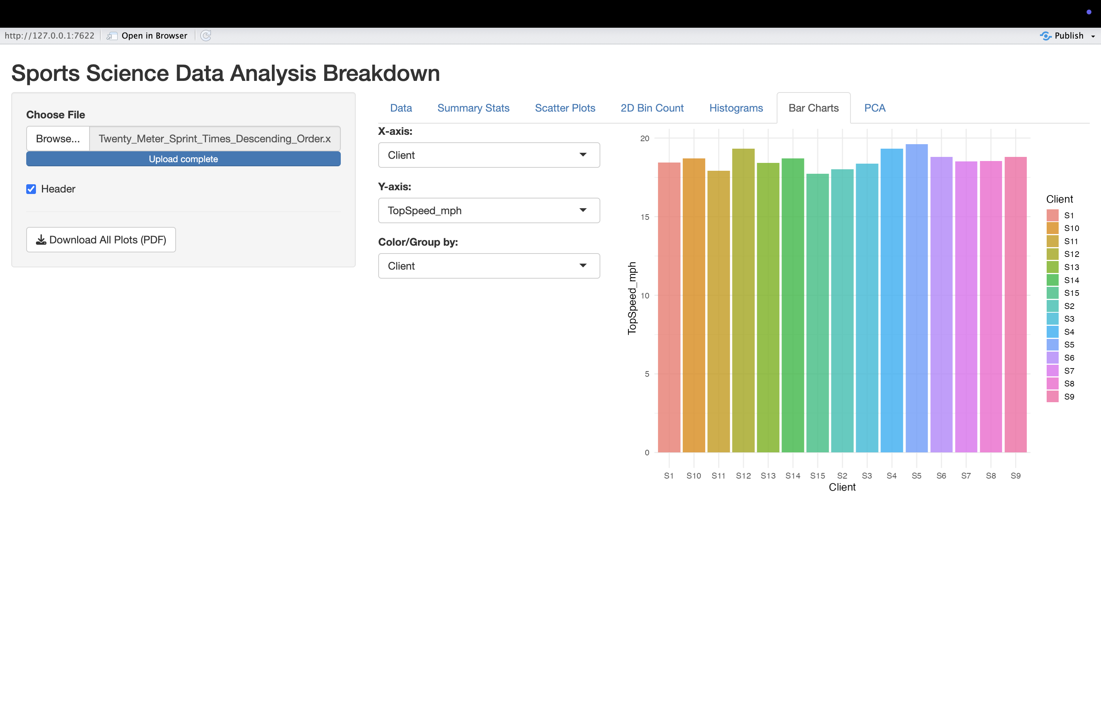
Bar Charts
Bar charts are used to visually compare quantities across different categories.
Here we see bar charts based upon the category of client.
The higher the bar, the higher the top speed.

Slide 11
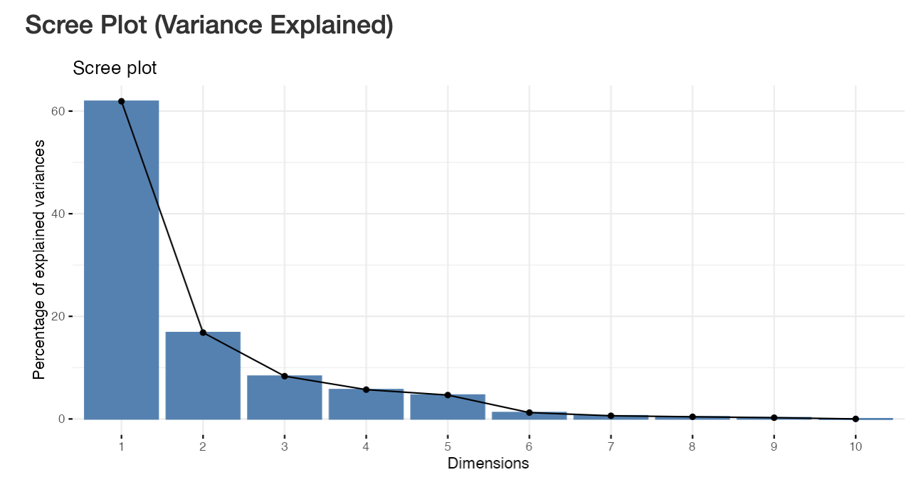
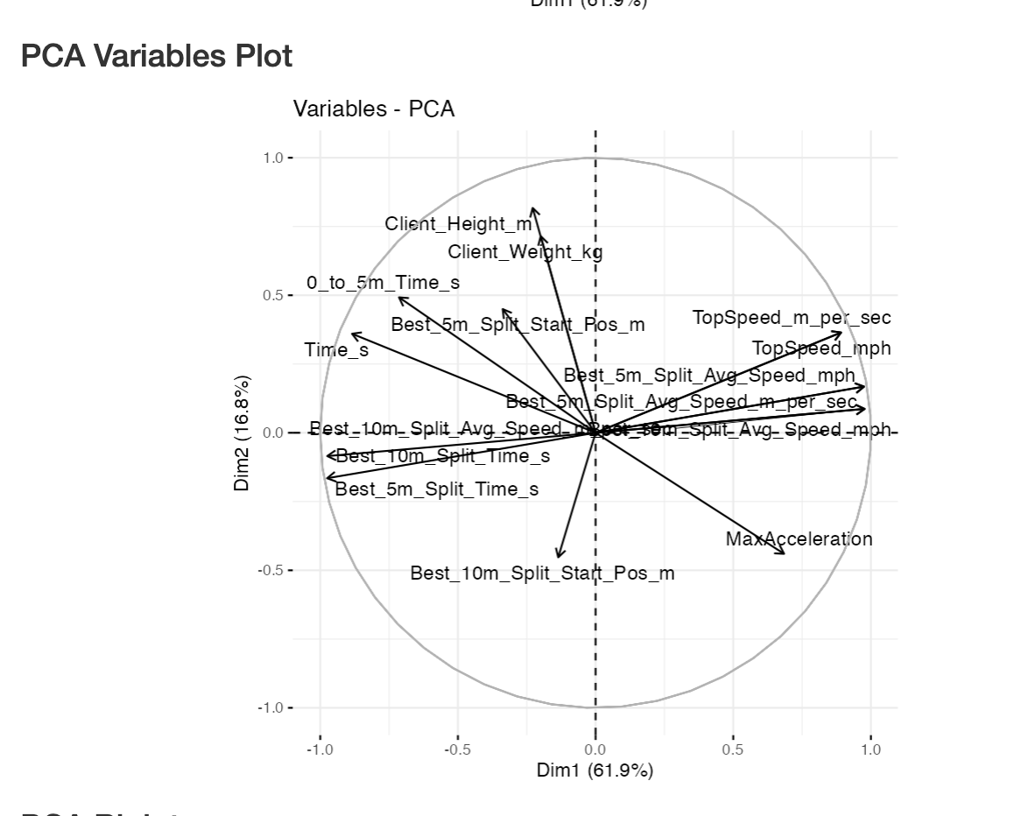
Principle Component Analysis
The purpose of a PCA is a dimensionality reduction technique used primarily for exploring and understanding high-dimensional data
Cluster of Variables | Meaning/ Interpretation | Direction
TopSpeed + Avg_Split_Speeds | Speed/Performance | Upward Strongly Right (Dim1+)
Split Times + Total Times | Opposite of speed (longer time = slower) | Bottom or Strongly left (Dim1–)
Client Height + Weight | Body size/structure | Upward Left (Dim2+)
MaxAcceleration | Explosiveness, overlaps speed slightly | Bottom Right (Dim1+, Dim2–)

Slide 12
Conclusion
S5 had the top speed out of the group of 15 athletes as displayed by the graphs in this presentation.
An additional piece of evidence to consider is that weight and height were not necessarily correlated with top speed, as seen in the PCA, indicating that athletes who have more mass, can move heavier than athletes who have less mass.
Despite body composition and distribution of limb mass not being accounted for in the data collected, future investigations may seek to understand if athletes with top speeds and higher body masses have different body compositions in their extremities, compared to their counterparts.

Slide 13
References
Asadi, A. (2016). Relationship between jumping ability, agility and sprint performance of elite young basketball players: a field-test approach. Revista brasileira de cineantropometria & desempenho humano, 18(2), 177-186.
Drinkwater, E. J., Pyne, D. B., & McKenna, M. J. (2008). Design and interpretation of anthropometric and fitness testing of basketball players. Sports medicine, 38(7), 565-578.
Klinzing, J. E. (1991). Training for improved jumping ability of basketball players. Strength & Conditioning Journal, 13(3), 27-33.
Latin, R. W., Berg, K., & Baechle, T. (1994). Physical and performance characteristics of NCAA division I male basketball players. The Journal of Strength & Conditioning Research, 8(4), 214-218.

